Slide 1
Cross Validation
Machine Learning With Python

Slide 2
Fit A Regression Model
Take 10 Minutes and Fit a Regression Model on the bostonhousing.csv data.
Make sure to:
1). Standardize your data
2). Look at your most important coefficients
3). Get an R^2 value. Should be 0.7406

Slide 3
How Do We Know Our Model Will Generalize To The Outside World?

Slide 4
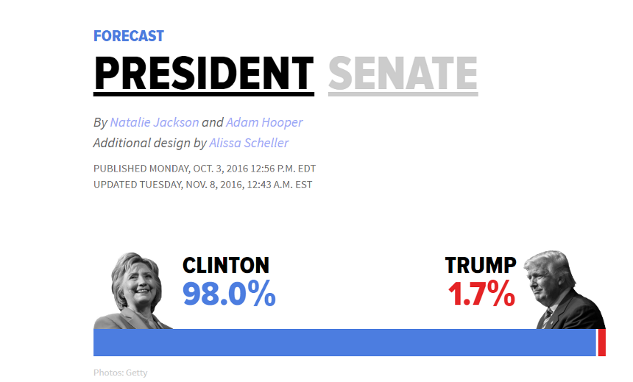

Slide 5
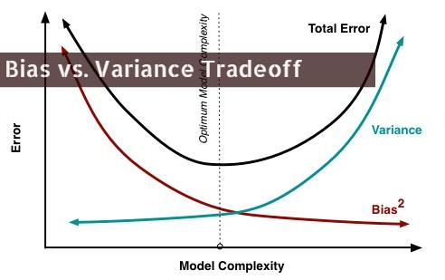

Slide 6
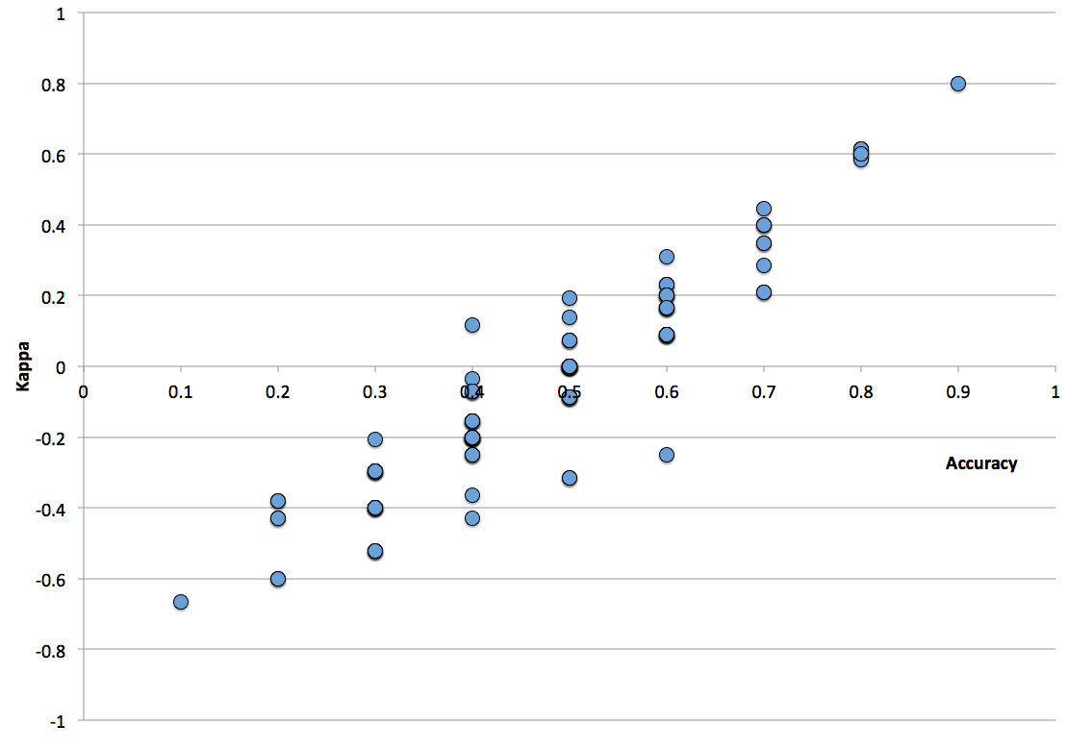
Cross Validation
Bias refers to when your data doesn't adequately capture the information necessary to solve your problem
Variance refers to when your model mistakenly interprets random correlations as meaningful

Slide 7
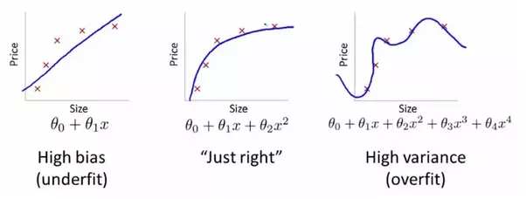

Slide 8
Cross Validation
Basic idea is simple:
Separate your data into two groups, a “test” set and a “training” set
Test set is not touched until the very end, and is only used for final model evaluation
Training set is used for fine-tuning and evaluating your model
Notes:
This is where you go and introduce the training and test split. Go through the shapes of the returned values, make sure everyone is clear on what’s happening.
For

Slide 9
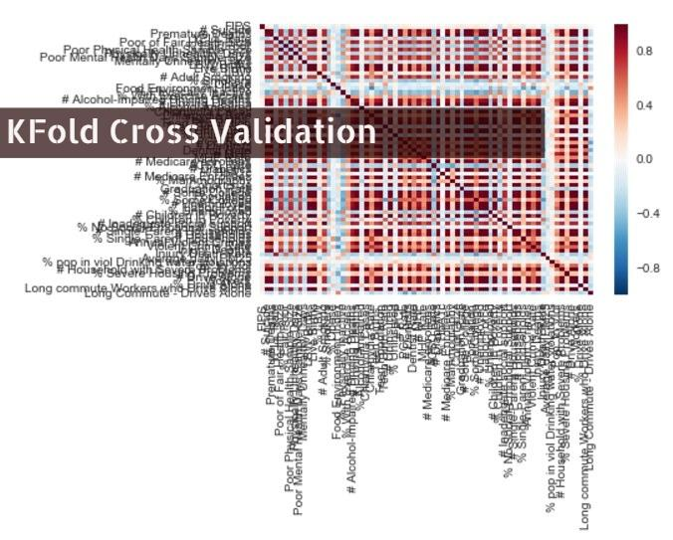
Notes:
This is where you go and introduce the training and test split. Go through the shapes of the returned values, make sure everyone is clear on what’s happening.
For

Slide 10
Cross Validation
Kfold Cross Validation:
More thorough way of cross validation
Split test set into K different groups
For k rounds, train your data on K-1 groups, and score it on the one remaining set
Is only used on the training set
Notes:
This is where you go and introduce the training and test split. Go through the shapes of the returned values, make sure everyone is clear on what’s happening.
For

Slide 11
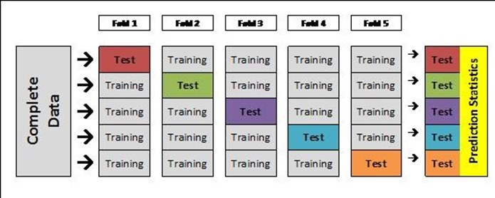
Notes:
After this slide, introduce cross_val_score and how to implement it

Slide 12
Cross Validation
Concept check:
What would be the expected behavior from increasing the number of folds?
When would a larger number of folds make sense?

Slide 13
Cross Validation
Key idea about cross validation:
Allows you to compare changes between models
Ie, your cross validated score gives you a benchmark to use to determine whether or not you’re making progress or not
Notes:
This is where you go and introduce the training and test split. Go through the shapes of the returned values, make sure everyone is clear on what’s happening.
For

Slide 14
Regression Exercise #2
Log transformations are often a good way to deal with non-regularities in your data.
This is especially common when used with your target variable.
Use the command np.log1p to transform y. And do the following:
Check your histogram of y before and after the transformation to compare the differences
Use 10 fold cross validation and compare your cross validated score with the original version of your data
Use random_state = 2019 when creating training and test sets?
Notes:
After this, re-fit on the entire training set, and then score your final model.

Slide 15
Regularization
Machine Learning With Python

Slide 16
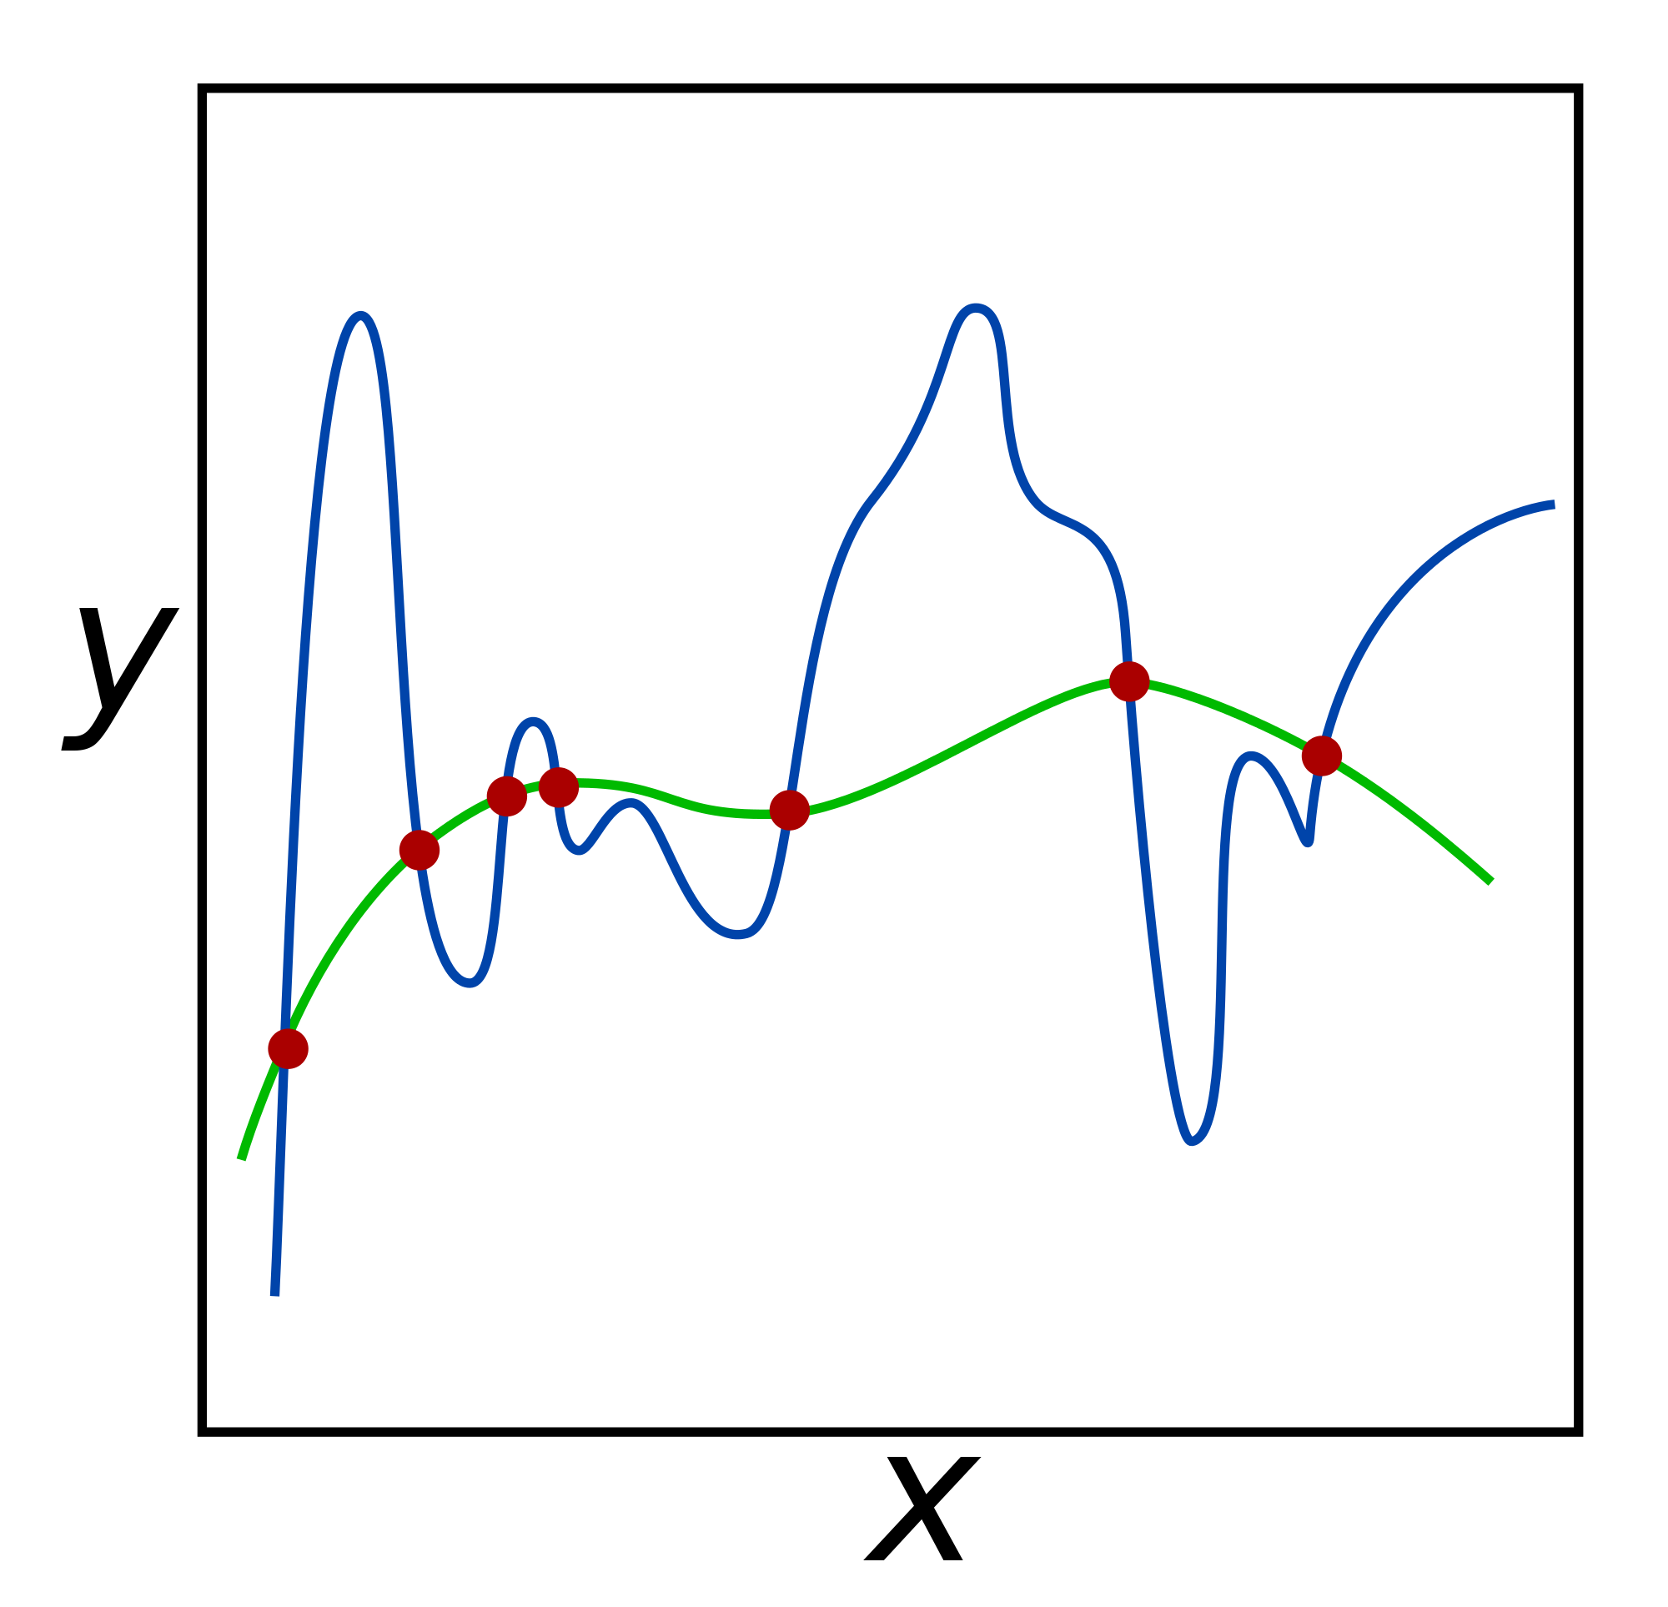
Regularization
Commonly used technique to curb overfitting in your models.
Does so by deliberately injecting a measured amount of bias into your model
You call bias injection a ‘penalty’
Result is that it shrinks your weights
Also known as ‘weight’ decay
Used in most algorithms that use gradient descent for optimization
Notes:
This is where you go and introduce the training and test split. Go through the shapes of the returned values, make sure everyone is clear on what’s happening.
For

Slide 17
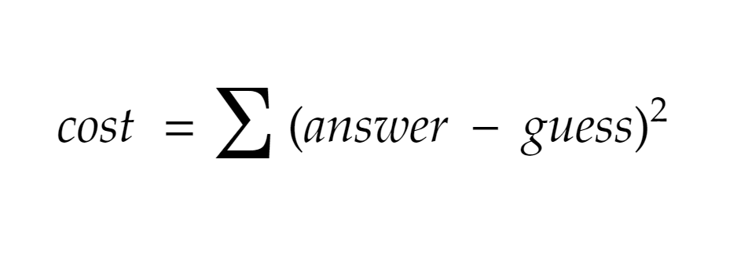

Slide 18
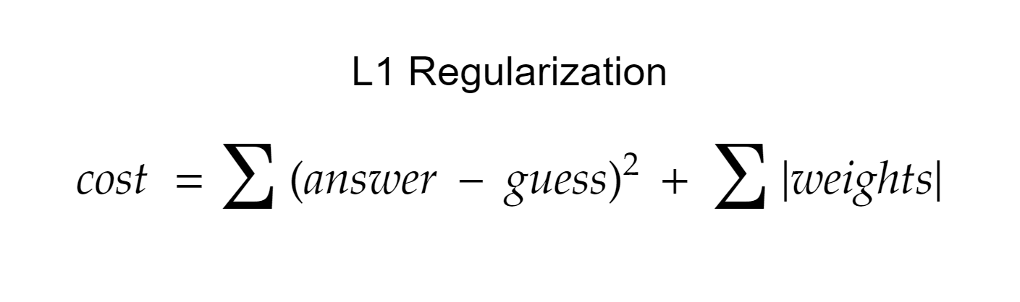

Slide 19
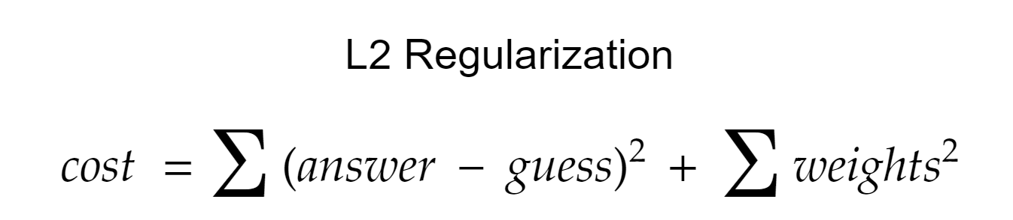

Slide 20
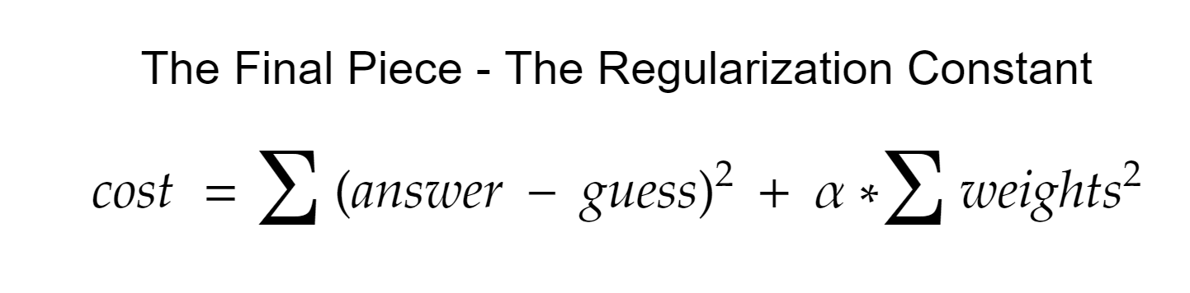
Notes:
Go into your next segment here, and

Slide 21
Regularization
The regularization parameter:
Has different names:
Alpha
Lambda
C
Determines the strength of your regularization
Common parameter to test in cross validation

Slide 22
Regularization
Regression with an L2 penalty is called Ridge Regression
Regression with an L1 penalty is called Lasso Regression
Regularization is used on a lot of ML algorithms - basic concepts are the same throughout
Always a good idea to regularize - to not do it is usually a mistake

Slide 23
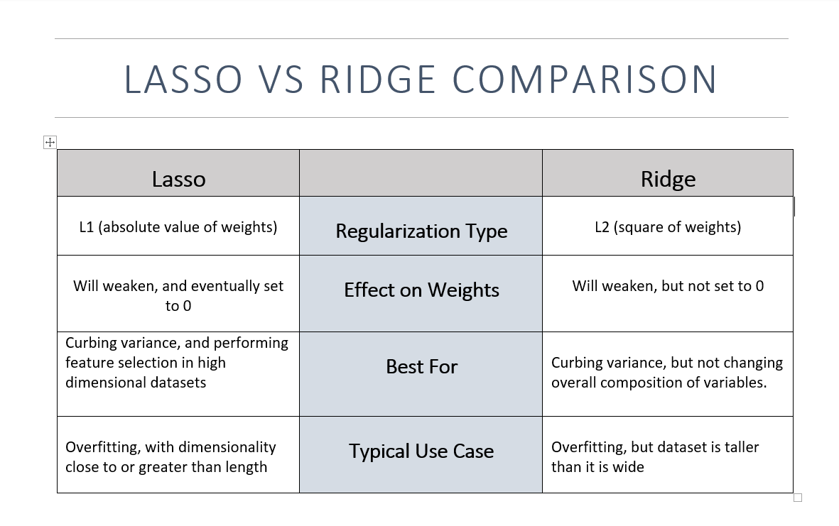
Notes:
After this slide, introduce Ridge Regression, point out alpha as a parameter, and make the chart -- decide for yourself if it’s a good idea to do it by hand or not.

Slide 24
Find the Regularization Constant
In a similar manner to before, use cross validation to find the ideal value of alpha for Lasso regression.
Write down the value of alpha, as well as the r_squared value for the best model.

